Slide 1
Software testing

Slide 2
INTRODUCTION
Software Testing is evaluation of the software against requirements gathered from users and system specifications.
It is the process of determining and assuring that the software system fulfills its scope and possesses quality in terms of functional and non functional requirements.
Software testing comprises of Validation and Verification.

Slide 3
Verification and Validation
Verification
Evaluation of software system that help in determining whether the product of a given development phase satisfy the requirements established before the start of that phase
Building the product correctly
Validation
Evaluation of software system that help in determining whether the product meets its intended use
Building the correct product

Slide 4
Failure Vs Error vs error vs defect
Error:
What: An error is a human-made mistake or a misunderstanding in the software development process.
Result: Errors can lead to defects (bugs) in the software.
Bug:
What: A bug is a defect or an issue in the software that causes it to behave incorrectly.
Result: Bugs can lead to failures when the software doesn't work as expected.
Failure:
What: A failure occurs when the software doesn't meet its intended behavior or doesn't satisfy the specified requirements during actual use.
Cause: Failures are typically caused by bugs that are triggered under specific conditions.
Defect:
What: A defect, often referred to as a "fault" or "anomaly," is a flaw or imperfection in the software's design, code, or documentation.
Role: Defects are the underlying cause of bugs when they result in incorrect behavior or unexpected issues.
Notes:
Fault causes error and error leads to failure.

Slide 5
To clarify further, let's use a simple example:
Example: Suppose a software requirement specifies that a user should be able to enter a positive number, and the software should then calculate the square root of that number. If the software sometimes gives incorrect square root values for certain inputs, there's a bug in the square root calculation.
Error: If the developer misunderstood the requirement and allowed negative numbers as input, that's an error.
Bug: The incorrect square root calculation for certain inputs is the bug.
Failure: If the software consistently gives incorrect square root values for positive inputs, causing user confusion, that's a failure.
Defect: The flaw in the square root calculation logic causing incorrect results is the defect.

Slide 6
Manual Vs Automated Testing
Manual - This testing is performed without taking help of automated testing tools. The software tester prepares test cases for different sections and levels of the code, executes the tests and reports the result to the manager.
Manual testing is time and resource consuming. The tester needs to confirm whether or not right test cases are used. Major portion of testing involves manual testing.
Automated This testing is a testing procedure done with aid of automated testing tools. The limitations with manual testing can be overcome using automated test tools.

Slide 7
Testing Approaches
Tests can be conducted based on two approaches:-
Functionality testing
Implementation testing
When functionality is being tested without taking the actual implementation in concern it is known as black-box testing. The other side is known as white-box testing where not only functionality is tested but the way it is implemented is also analyzed.

Slide 8
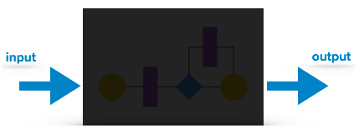
Black-box testing
It is carried out to test functionality of the program. It is also called ‘Behavioral’ testing. The tester in this case, has a set of input values and respective desired results. On providing input, if the output matches with the desired results, the program is tested ‘ok’, and problematic otherwise.
In this testing method, the design and structure of the code are not known to the tester, and testing engineers and end users conduct this test on the software.

Slide 9
Black-box testing Approaches
Equivalence class Partitioning (ECP)- The input is divided into similar classes. If one element of a class passes the test, it is assumed that all the class is passed.
Boundary values - The input is divided into higher and lower end values. If these values pass the test, it is assumed that all values in between may pass too.
Cause-effect graphing - In both previous methods, only one input value at a time is tested. Cause (input) – Effect (output) is a testing technique where combinations of input values are tested in a systematic way.
Domain Analysis Testing - Domain analysis is a technique that can be used to identify efficient and effective test cases when multiple variables can or should be tested together.
State-based testing - The system changes state on provision of input. These systems are tested based on their states and input.

Slide 10
Example of ECP
One application is accepting input range from 1 to 100,
Test Cases:
One is for valid input class i.e. selects any value from input between ranges 1 to 100.
One is for invalid data below lower limit i.e. any one value below 1.
One is for invalid data above upper limit i.e. any value above 100.

Slide 11
Example of BVA
One application is accepting input range from 1 to 100,
Test Cases:
One test case for exact boundary values of input domains each means 1 and 100.
One test case for just below boundary value of input domains each means 0 and 99.
One test case for just above boundary values of input domains each means 2 and 101.

Slide 12
Cause Effect graph example
The Causes of this situation are: C1 – First character is A C2 – First character is B C3 – the Second character is a digit
The Effects (results) for this situation are: E1 – Update the file E2 – Print message “X” E3 – Print message “Y”

Slide 13
Cause Effect graph example
In this example, let’s start with Effect E1.
Effect E1 is for updating the file. The file is updated when – The first character is “A” and the second character is a digit – The first character is “B” and the second character is a digit – The first character can either be “A” or “B” and cannot be both.

Slide 14
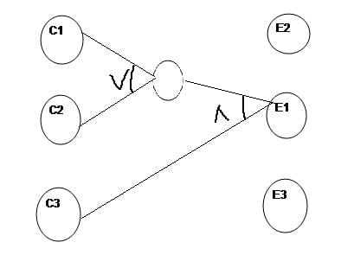
Cause Effect graph example

Slide 15
Domain Analysis Example
Consider a games exhibition for Children, 6 competitions are laid out, and tickets have to be given according to the age and gender input. The ticketing is one of the modules to be tested in for the whole functionality of Games exhibition.
According to the scenario, we got six scenarios based on the age and the competitions:

Slide 16
Domain Analysis Example
Age >5 and <10, Boy should participate in Storytelling.
Age >5 and <10 , girl should participate in Drawing Competition.
Age >10 and <15, Boy should participate in Quiz.
Age >10 and <15 , girl should participate in Essay writing.
Age<5, both boys and girls should participate in Rhymes Competition.
Age >15, both boys and girls should participate in Poetry competition.
Here the input will be Age and Gender and hence the ticket for the competition will be issued. This case partition of inputs or simply grouping of values come into the picture.

Slide 17
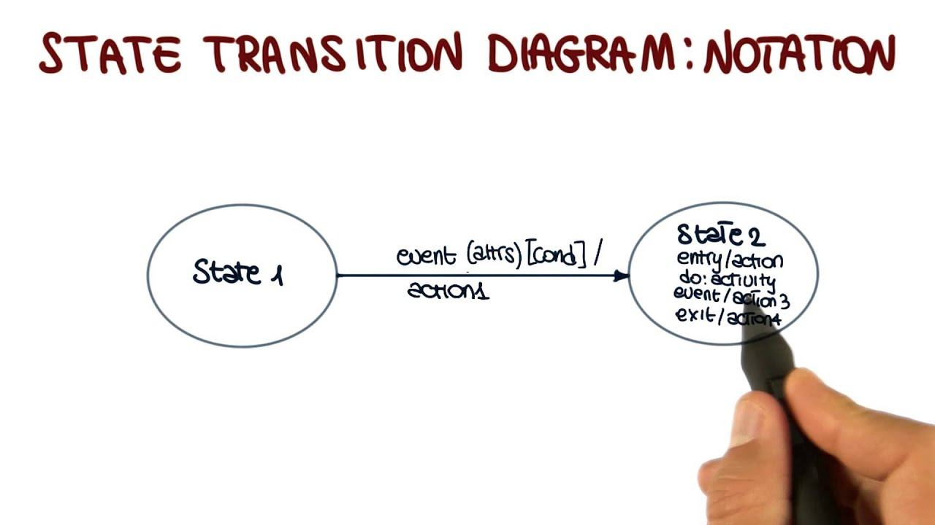

Slide 18
State Transition Test Example
Login page of a software which locks the user name after three wrong attempts of password.

Slide 19
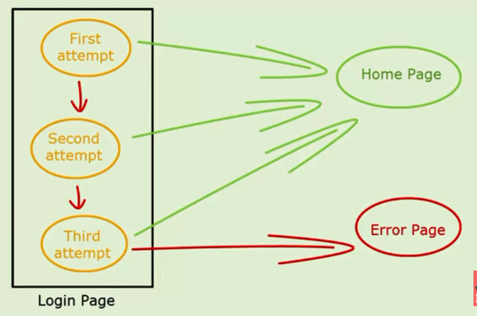
State Transition Test Example

Slide 20
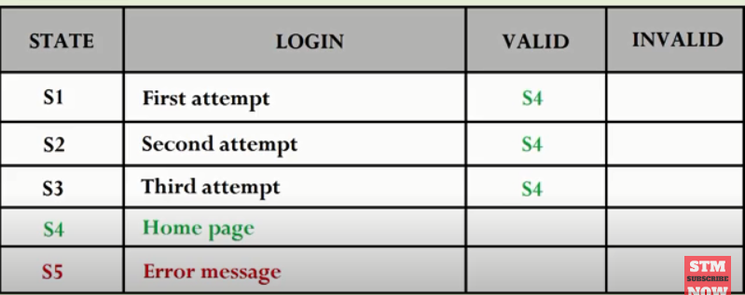
Example 1 : Valid transitions

Slide 21
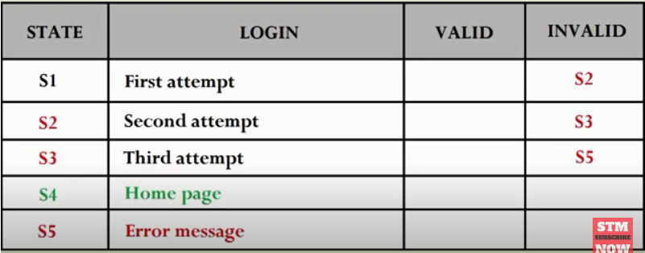
Example 1 : Invalid transitions

Slide 22
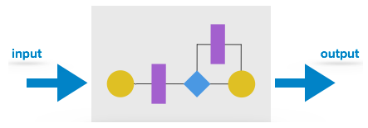
White-box testing
It is conducted to test program and its implementation, in order to improve code efficiency or structure. It is also known as ‘Structural’ testing.
In this testing method, the design and structure of the code are known to the tester. Programmers of the code conduct this test on the code.

Slide 23
White-box testing techniques
The below are some White-box testing techniques:
Control-flow testing - The purpose of the control-flow testing to set up test cases which covers all statements and branch conditions. The branch conditions are tested for both being true and false, so that all statements can be covered. We have different criteria such as
Statement Testing
Decision Testing
Condition Testing
Data-flow testing - This testing technique emphasis to cover all the data variables included in the program. It tests where the variables were declared and defined and where they were used or changed.

Slide 24
White-box testing techniques
Mutation Testing is a type of software testing where we mutate (change) certain statements in the source code and check if the test cases are able to find the errors.
It is a type of White Box Testing which is mainly used for Unit Testing.
The changes in mutant program are kept extremely small, so it does not affect the overall objective of the program.

Slide 25
White-box testing techniques
A program slice is a subset of a program which is done to identify
If I change a statement in program:
What other statements would be affected? (Impact analysis)
What other statement needs to be tested? (Regression test)
The values live at this statement: Defined where?
Modified Where?

Slide 26
Testing Levels
Testing itself may be defined at various levels of SDLC. The testing process runs parallel to software development. Before jumping on the next stage, a stage is tested, validated and verified. Testing separately is done just to make sure that there are no hidden bugs or issues left in the software. Software is tested on various levels -
Unit Testing: While coding, the programmer performs some tests on that unit of program to know if it is error free. Testing is performed under white-box or black box testing approach. Unit testing helps developers decide that individual units of the program are working as per requirement and are error free.
Integration Testing: Even if the units of software are working fine individually, there is a need to find out if the units if integrated together would also work without errors. For example, argument passing and data updation etc.

Slide 27
Testing level
System Testing
The software is compiled as product and then it is tested as a whole. This can be accomplished using one or more of the following tests:
Functionality testing - Tests all functionalities of the software against the requirement.
Performance testing - This test proves how efficient the software is. It tests the effectiveness and average time taken by the software to do desired task. Performance testing is done by means of load testing and stress testing where the software is put under high user and data load under various environment conditions.
Security & Portability - These tests are done when the software is meant to work on various platforms and accessed by number of persons.

Slide 28
Testing level
Acceptance Testing
When the software is ready to hand over to the customer it has to go through last phase of testing where it is tested for user-interaction and response. This is important because even if the software matches all user requirements and if user does not like the way it appears or works, it may be rejected.
Alpha testing - The team of developer themselves perform alpha testing by using the system as if it is being used in work environment. They try to find out how user would react to some action in software and how the system should respond to inputs.
Beta testing - After the software is tested internally, it is handed over to the users to use it under their production environment only for testing purpose. This is not as yet the delivered product. Developers expect that users at this stage will bring minute problems, which were skipped to attend.
.

Slide 29
Testing level
Regression Testing
Whenever a software product is updated with new code, feature or functionality, it is tested thoroughly to detect if there is any negative impact of the added code. This is known as regression testing

Slide 30
Testing Documentation
Before Testing
Testing starts with test cases generation. Following documents are needed for reference –
SRS document - Functional Requirements document
Test Policy document - This describes how far testing should take place before releasing the product.
Test Strategy document - This mentions detail aspects of test team, responsibility matrix and rights/responsibility of test manager and test engineer.

Slide 31
Testing documentation
While Being Tested
The following documents may be required while testing is started and is being done:
Test Case document - This document contains list of tests required to be conducted. It includes Unit test plan, Integration test plan, System test plan and Acceptance test plan.
Test description - This document is a detailed description of all test cases and procedures to execute them.
Test case report - This document contains test case report as a result of the test.
Test logs - This document contains test logs for every test case report.

Slide 32
Testing documentation
After Testing
The following documents may be generated after testing :
Test summary - This test summary is collective analysis of all test reports and logs. It summarizes and concludes if the software is ready to be launched. The software is released under version control system if it is ready to launch.

